Slide 1


Slide 3
Linked SEMI

Slide 4
Linked SEMI

Slide 5
LinkedSEMI
4500*960

Slide 6
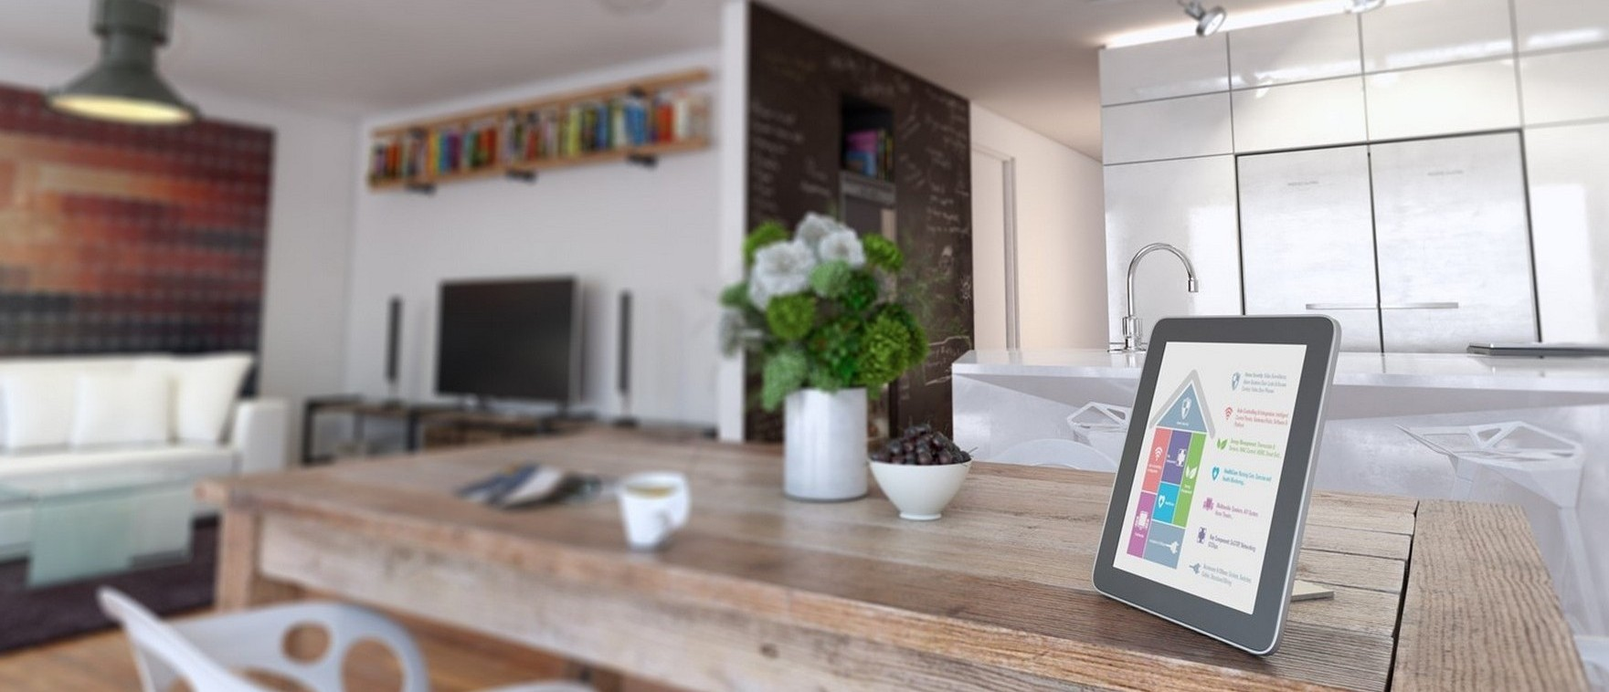

Slide 7

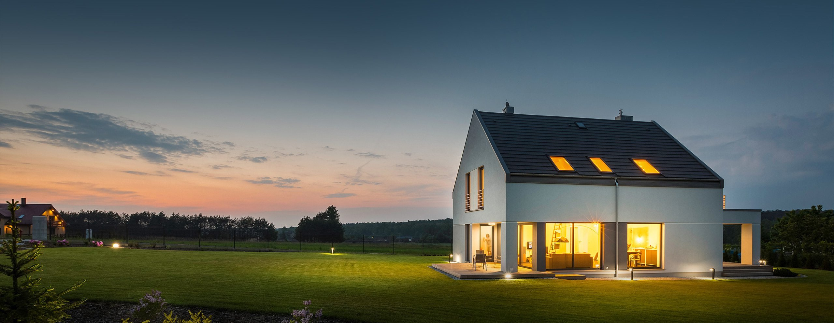

Slide 8

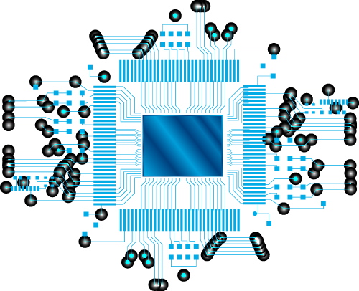
1910*770

Slide 9
1910*770

Slide 10
1910*770

Slide 11


Bluetooth 5.1
By LinkedSEMI

